Slide 1
Digital Design & Computer Arch. Lecture 23b: Virtual Memory
Prof. Onur Mutlu
ETH Zürich
Spring 2020
22 May 2020

Slide 2
Readings
Virtual Memory
Required
H&H Chapter 8.4

Slide 3
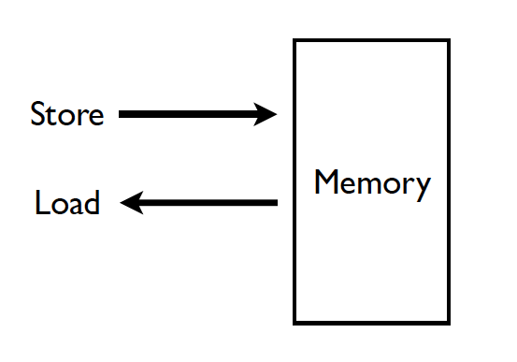
Memory (Programmer’s View)

Slide 4
Ideal Memory
Zero access time (latency)
Infinite capacity
Zero cost
Infinite bandwidth (to support multiple accesses in parallel)

Slide 5
Abstraction: Virtual vs. Physical Memory
Programmer sees virtual memory
Can assume the memory is “infinite”
Reality: Physical memory size is much smaller than what the programmer assumes
The system (system software + hardware, cooperatively) maps virtual memory addresses to physical memory
The system automatically manages the physical memory space transparently to the programmer
+ Programmer does not need to know the physical size of memory nor manage it → A small physical memory can appear as a huge one to the programmer → Life is easier for the programmer
-- More complex system software and architecture
A classic example of the programmer/(micro)architect tradeoff

Slide 6
Benefits of Automatic Management of Memory
Programmer does not deal with physical addresses
Each process has its own mapping from virtual→physical addresses
Enables
Code and data to be located anywhere in physical memory
(relocation)
Isolation/separation of code and data of different processes in physical memory
(protection and isolation)
Code and data sharing between multiple processes
(sharing)

Slide 7
A System with Physical Memory Only
Examples:
most Cray machines
early PCs
many embedded systems
CPU’s load or store addresses used
directly to access memory
Memory
0:
Physical
Addresses
1:
CPU
N-1:
Notes:
Ask about what are the potential problems? (Size, segmentation, security)

Slide 8
The Problem
Physical memory is of limited size (cost)
What if you need more?
Should the programmer be concerned about the size of code/data blocks fitting physical memory?
Should the programmer manage data movement from disk to physical memory?
Should the programmer ensure two processes (different programs) do not use the same physical memory?
Also, ISA can have an address space greater than the physical memory size
E.g., a 64-bit address space with byte addressability
What if you do not have enough physical memory?

Slide 9
Difficulties of Direct Physical Addressing
Programmer needs to manage physical memory space
Inconvenient & hard
Harder when you have multiple processes
Difficult to support code and data relocation
Addresses are directly specified in the program
Difficult to support multiple processes
Protection and isolation between multiple processes
Sharing of physical memory space
Difficult to support data/code sharing across processes

Slide 10
Virtual Memory
Idea: Give the programmer the illusion of a large address space while having a small physical memory
So that the programmer does not worry about managing physical memory
Programmer can assume he/she has “infinite” amount of physical memory
Hardware and software cooperatively and automatically manage the physical memory space to provide the illusion
Illusion is maintained for each independent process

Slide 11
Basic Mechanism
Indirection (in addressing)
Address generated by each instruction in a program is a “virtual address”
i.e., it is not the physical address used to address main memory
called “linear address” in x86
An “address translation” mechanism maps this address to a “physical address”
called “real address” in x86
Address translation mechanism can be implemented in hardware and software together

Slide 12
A System with Virtual Memory (Page based)
Address Translation: The hardware converts virtual addresses into physical addresses via an OS-managed lookup table (page table)
Memory
0:
Page Table
1:
Virtual
Addresses
Physical
Addresses
0:
1:
CPU
P-1:
N-1:
Disk

Slide 13
Virtual Pages, Physical Frames
Virtual address space divided into pages
Physical address space divided into frames
A virtual page is mapped to
A physical frame, if the page is in physical memory
A location in disk, otherwise
If an accessed virtual page is not in memory, but on disk
Virtual memory system brings the page into a physical frame and adjusts the mapping → this is called demand paging
Page table is the table that stores the mapping of virtual pages to physical frames

Slide 14
Physical Memory as a Cache
In other words…
Physical memory is a cache for pages stored on disk
In fact, it is a fully associative cache in modern systems (a virtual page can potentially be mapped to any physical frame)
Similar caching issues exist as we have covered earlier:
Placement: where and how to place/find a page in cache?
Replacement: what page to remove to make room in cache?
Granularity of management: large, small, uniform pages?
Write policy: what do we do about writes? Write back?

Slide 15
Cache/Virtual Memory Analogues
Cache | Virtual Memory
Block | Page
Block Size | Page Size
Block Offset | Page Offset
Miss | Page Fault
Tag | Virtual Page Number

Slide 16
Virtual Memory Definitions
Page size: amount of memory transferred from hard disk to DRAM at once
Address translation: determining the physical address from the virtual address
Page table: lookup table used to translate virtual addresses to physical addresses (and find where the associated data is)

Slide 17
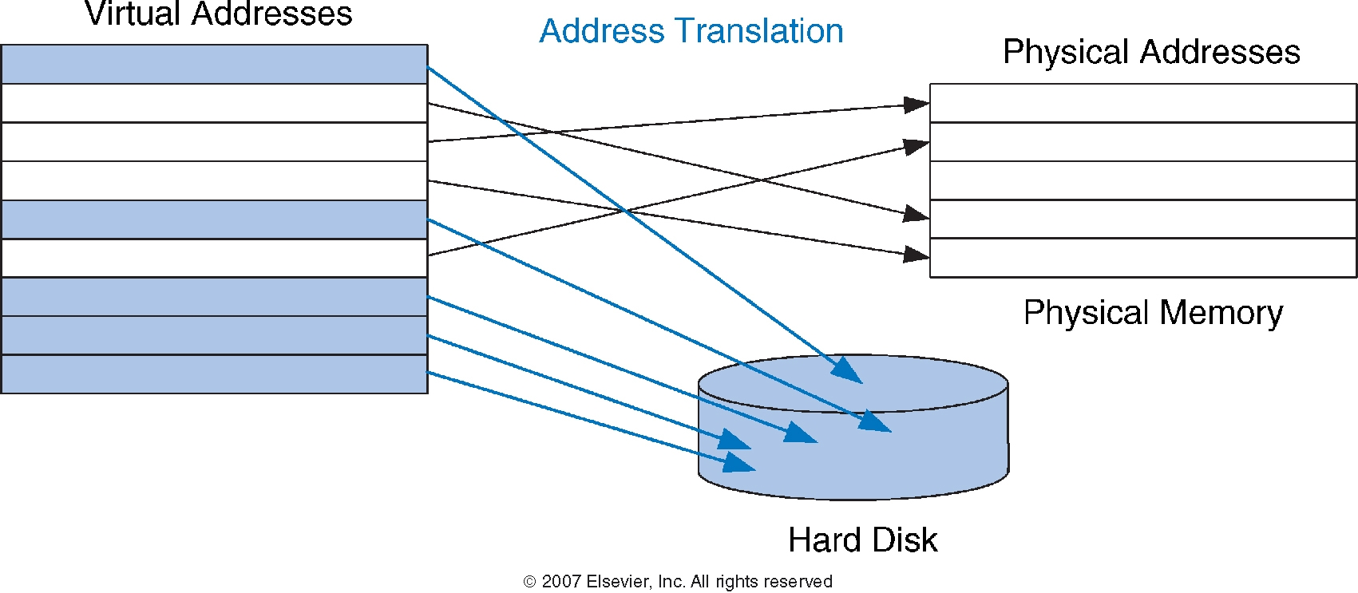
Virtual and Physical Addresses
Most accesses hit in physical memory
But programs see the large capacity of virtual memory
17

Slide 18
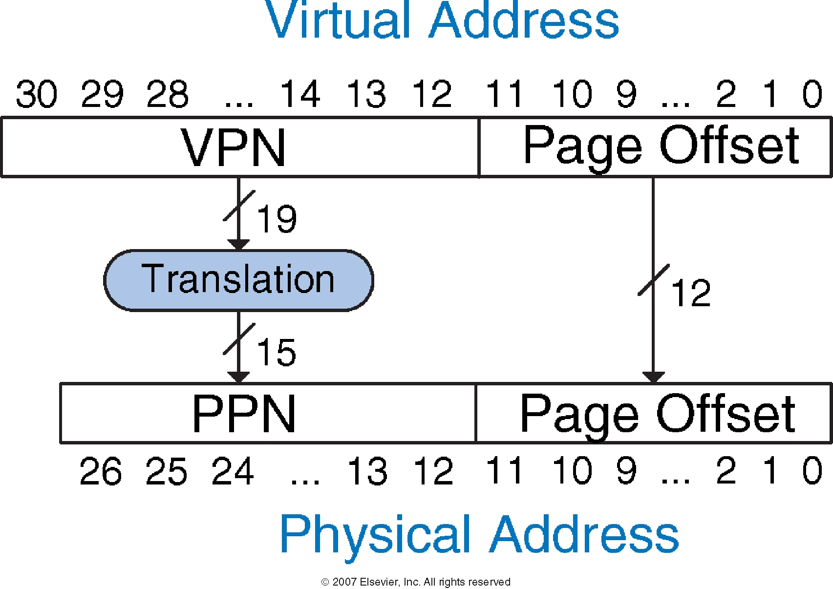
Address Translation

Slide 19
Virtual Memory Example
System:
Virtual memory size: 2 GB = 2³¹ bytes
Physical memory size: 128 MB = 2²⁷ bytes
Page size: 4 KB = 2¹² bytes

Slide 20
Virtual Memory Example
System:
Virtual memory size: 2 GB = 2³¹ bytes
Physical memory size: 128 MB = 2²⁷ bytes
Page size: 4 KB = 2¹² bytes
Organization:
Virtual address: 31 bits
Physical address: 27 bits
Page offset: 12 bits
# Virtual pages = 2³¹/2¹² = 2¹⁹ (VPN = 19 bits)
# Physical pages = 2²⁷/2¹² = 2¹⁵ (PPN = 15 bits)

Slide 21
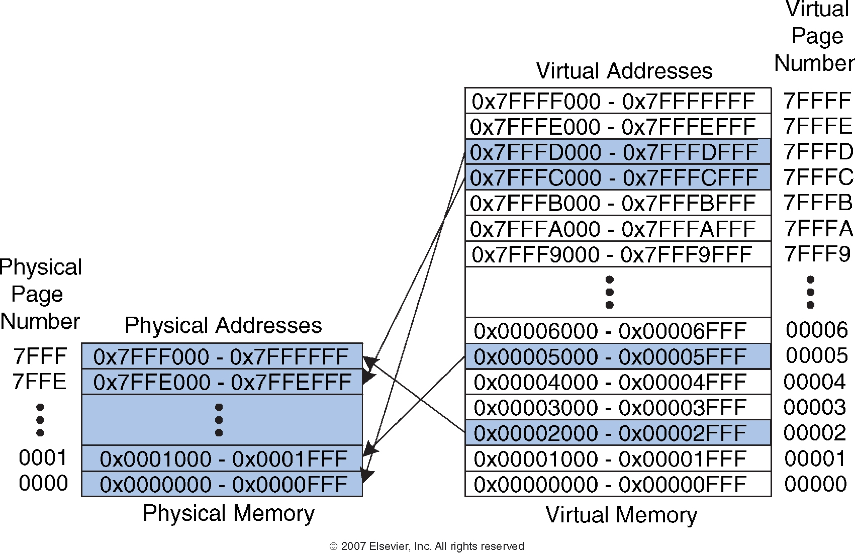
Virtual Memory Example

Slide 22
Digital Design & Computer Arch. Lecture 23b: Virtual Memory
Prof. Onur Mutlu
ETH Zürich
Spring 2020
22 May 2020

Slide 23
We did not cover the following slides in lecture. These are for your benefit.

Slide 24
How Do We Translate Addresses?
Page table
Has entry for each virtual page
Each page table entry has:
Valid bit: whether the virtual page is located in physical memory (if not, it must be fetched from the hard disk)
Physical page number: where the virtual page is located in physical memory
(Replacement policy, dirty bits)

Slide 25
Page Table Example

Slide 26
Page Table Example 1
What is the physical address of virtual address 0x5F20?
26

Slide 27
Page Table Example 1
What is the physical address of virtual address 0x5F20?
VPN = 5
Entry 5 in page table indicates VPN 5 is in physical page 1
Physical address is 0x1F20
27

Slide 28
Page Table Example 2
What is the physical address of virtual address 0x73E0?
28

Slide 29
Page Table Example 2
What is the physical address of virtual address 0x73E0?
VPN = 7
Entry 7 in page table is invalid, so the page is not in physical memory
The virtual page must be swapped into physical memory from disk
29

Slide 30
Issue: Page Table Size
64-bit
Suppose 64-bit VA and 40-bit PA, how large is the page table?
2⁵² entries x ~4 bytes ≈ 2⁵⁴ bytes
and that is for just one process!
and the process may not be using the entire VM space!
VPN
Page Offset
52-bit
12-bit
page
table
concat
PA
28-bit
40-bit

Slide 31
Page Table Challenges
Page table is large
at least part of it needs to be located in physical memory
Each load/store requires at least two memory accesses:
1. one for address translation (page table read)
2. one to access data with the physical address (after translation)
Two memory accesses to service a load/store greatly degrades load/store execution time
Unless we are clever…

Slide 32
Translation Lookaside Buffer (TLB)
Idea: Cache the page table entries (PTEs) in a hardware structure in the processor
Translation lookaside buffer (TLB)
Small cache of most recently used translations (PTEs)
Reduces number of memory accesses required for most loads/stores to only one

Slide 33
Translation Lookaside Buffer (TLB)
Page table accesses have a lot of temporal locality
Data accesses have temporal and spatial locality
Large page size (say 4KB, 8KB, or even 1-2GB), so consecutive loads/stores likely to access same page
TLB
Small: accessed in < 1 cycle
Typically 16 - 512 entries
High associativity
> 95-99 % hit rates typical (depends on workload)
Reduces # of memory accesses for most loads and stores to only 1

Slide 34
Example Two-Entry TLB

Slide 35
Memory Protection
Multiple programs (processes) run at once
Each process has its own page table
Each process can use entire virtual address space without worrying about where other programs are
A process can only access physical pages mapped in its page table – cannot overwrite memory of another process
Provides protection and isolation between processes
Enables access control mechanisms per page

Slide 36
Page Table is Per Process
Each process has its own virtual address space
Full address space for each program
Simplifies memory allocation, sharing, linking and loading.
0
Physical Address
Space (DRAM)
Virtual Address Space for Process 1:
0
Address Translation
VP 1
PP 2
VP 2
...
N-1
(e.g., read/only library code)
PP 7
Virtual Address Space for Process 2:
0
VP 1
VP 2
PP 10
...
N-1
M-1

Slide 37
Virtual Memory Summary
Virtual memory gives the illusion of “infinite” capacity
A subset of virtual pages are located in physical memory
A page table maps virtual pages to physical pages – this is called address translation
A TLB speeds up address translation
Using different page tables for different programs provides memory protection

Slide 38
Digital Design & Computer Arch. Lecture 23b: Virtual Memory
Prof. Onur Mutlu
ETH Zürich
Spring 2020
22 May 2020

Slide 39
Supporting Virtual Memory
Virtual memory requires both HW+SW support
Page Table is in memory
Can be cached in special hardware structures called Translation Lookaside Buffers (TLBs)
The hardware component is called the MMU (memory management unit)
Includes Page Table Base Register(s), TLBs, page walkers
It is the job of the software to leverage the MMU to
Populate page tables, decide what to replace in physical memory
Change the Page Table Register on context switch (to use the running thread’s page table)
Handle page faults and ensure correct mapping

Slide 40
Some System Software Jobs for VM
Keeping track of which physical frames are free
Allocating free physical frames to virtual pages
Page replacement policy
When no physical frame is free, what should be swapped out?
Sharing pages between processes
Copy-on-write optimization
Page-flip optimization

Slide 41
Page Fault (“A Miss in Physical Memory”)
If a page is not in physical memory but disk
Page table entry indicates virtual page not in memory
Access to such a page triggers a page fault exception
OS trap handler invoked to move data from disk into memory
Other processes can continue executing
OS has full control over placement
Before fault
After fault
Memory
Memory
Page Table
Virtual
Addresses
Physical
Addresses
Page Table
Virtual
Addresses
Physical
Addresses
CPU
CPU
Disk
Disk

Slide 42
Servicing a Page Fault
(1) Processor signals controller
Read block of length P starting at disk address X and store starting at memory address Y
(2) Read occurs
Direct Memory Access (DMA)
Under control of I/O controller
(3) Controller signals completion
Interrupt processor
OS resumes suspended process
(1) Initiate Block Read
Processor
Reg
(3) Read Done
Cache
Memory-I/O bus
(2) DMA Transfer
I/O
controller
Memory
Disk
Disk

Slide 43
Address Translation
How to obtain the physical address from a virtual address?
Page size specified by the ISA
VAX: 512 bytes
Today: 4KB, 8KB, 2GB, … (small and large pages mixed together)
Trade-offs? (remember cache lectures)
Page Table contains an entry for each virtual page
Called Page Table Entry (PTE)
What is in a PTE?

Slide 44
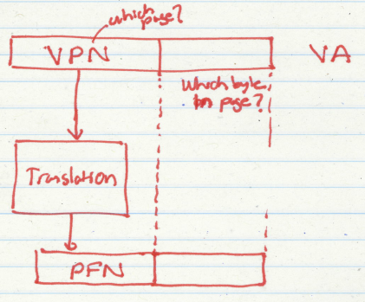
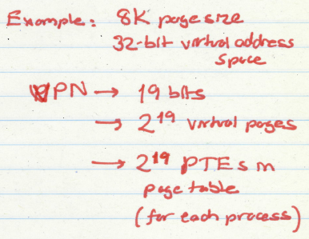
Address Translation (II)

Slide 45
Address Translation (III)
Parameters
P = 2^{p} = page size (bytes).
N = 2^{n} = Virtual-address limit
M = 2^{m} = Physical-address limit
n–1
p
p–1
0
virtual page number
page offset
virtual address
address translation
m–1
p
p–1
0
physical frame number
page offset
physical address
Page offset bits don’t change as a result of translation

Slide 46
Address Translation (IV)
Separate (set of) page table(s) per process
VPN forms index into page table (points to a page table entry)
Page Table Entry (PTE) provides information about page
page table
base register
(per process)
virtual address
0
n–1
p
p–1
virtual page number (VPN)
page offset
valid
access
physical frame number (PFN)
VPN acts as
table index
if valid=0
then page
not in memory (page fault)
m–1
p
p–1
0
physical frame number (PFN)
page offset
physical address

Slide 47
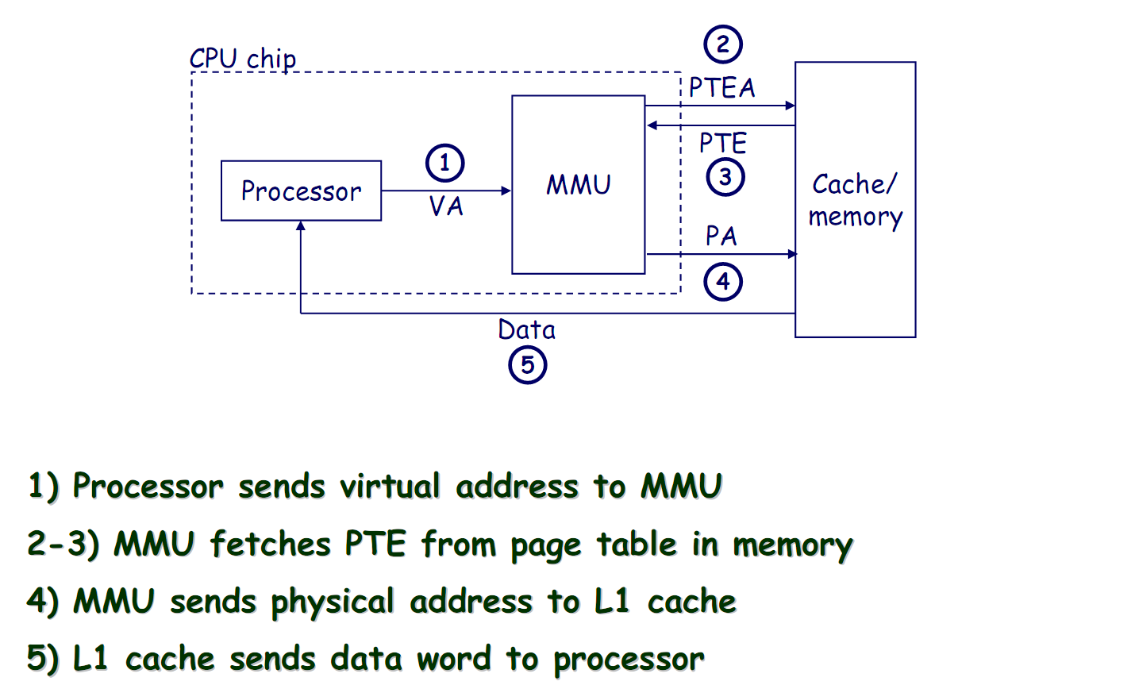
Address Translation: Page Hit

Slide 48
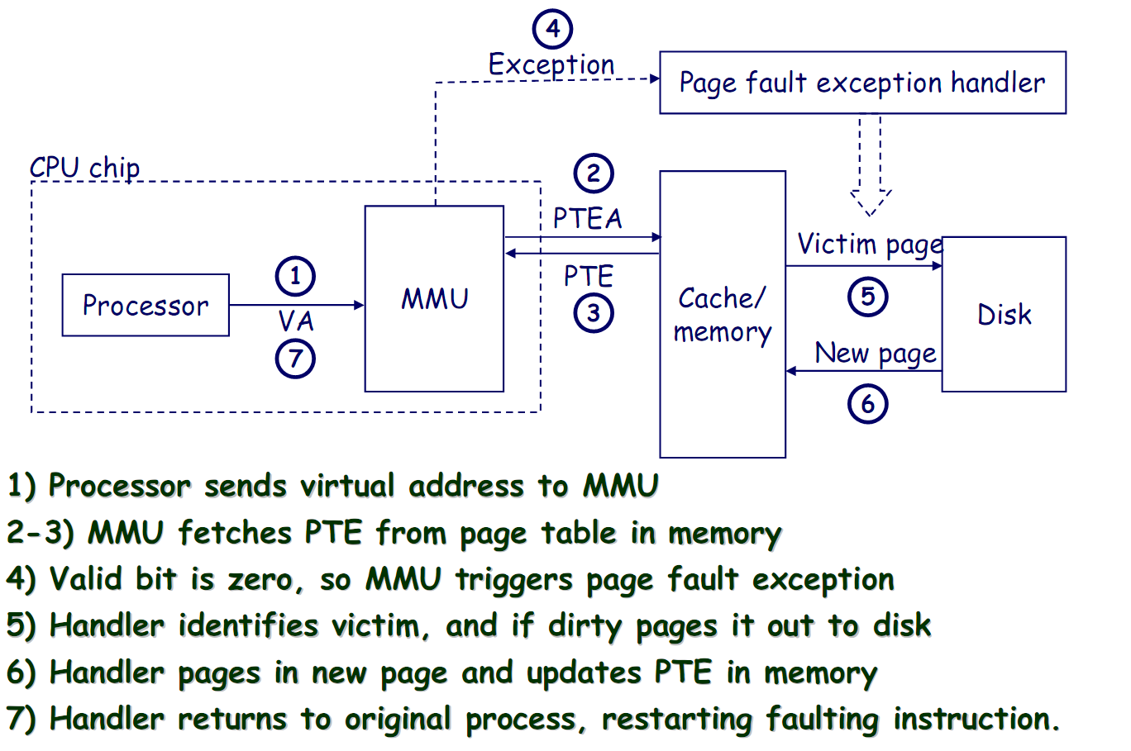
Address Translation: Page Fault

Slide 49
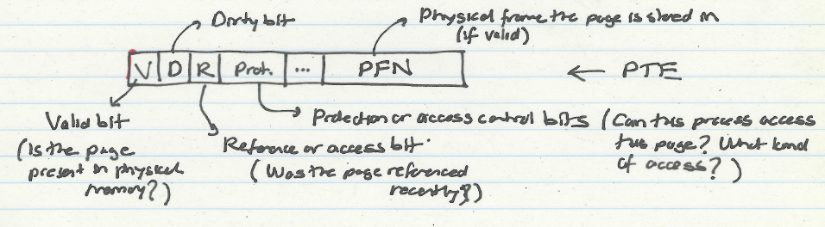
What Is in a Page Table Entry (PTE)?
Page table is the “tag store” for the physical memory data store
A mapping table between virtual memory and physical memory
PTE is the “tag store entry” for a virtual page in memory
Need a valid bit → to indicate validity/presence in physical memory
Need tag bits (PFN) → to support translation
Need bits to support replacement
Need a dirty bit to support “write back caching”
Need protection bits to enable access control and protection

Slide 50
Cache versus Page Replacement
Physical memory (DRAM) is a cache for disk
Usually managed by system software via the virtual memory subsystem
Page replacement is similar to cache replacement
Page table is the “tag store” for physical memory data store
What is the difference?
Required speed of access to cache vs. physical memory
Number of blocks in a cache vs. physical memory
“Tolerable” amount of time to find a replacement candidate (disk versus memory access latency)
Role of hardware versus software

Slide 51
Page Replacement Algorithms
If physical memory is full (i.e., list of free physical pages is empty), which physical frame to replace on a page fault?
Is True LRU feasible?
4GB memory, 4KB pages, how many possibilities of ordering?
Modern systems use approximations of LRU
E.g., the CLOCK algorithm
And, more sophisticated algorithms to take into account “frequency” of use
E.g., the ARC algorithm
Megiddo and Modha, “ARC: A Self-Tuning, Low Overhead Replacement Cache,” FAST 2003.

Slide 52
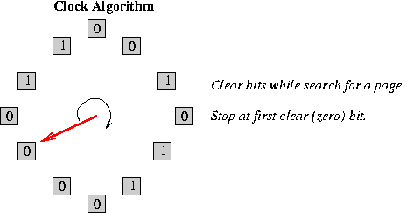
CLOCK Page Replacement Algorithm
Keep a circular list of physical frames in memory
Keep a pointer (hand) to the last-examined frame in the list
When a page is accessed, set the R bit in the PTE
When a frame needs to be replaced, replace the first frame that has the reference (R) bit not set, traversing the circular list starting from the pointer (hand) clockwise
During traversal, clear the R bits of examined frames
Set the hand pointer to the next frame in the list

